Slide 1
Should ENIAC apply discounts?
Zhanna Borodaeva zhborodaeva@gmail.com

Slide 2

Problem Statement
Marketing wants to apply discounts, because they help the company to grow
Board is unsure about applying discounts because they want to position the company in the quality segment and revenue decreased in last quarter while orders increased
The Task: Check the data to see whether discounts should be applied or not applied to increase revenue

Slide 3
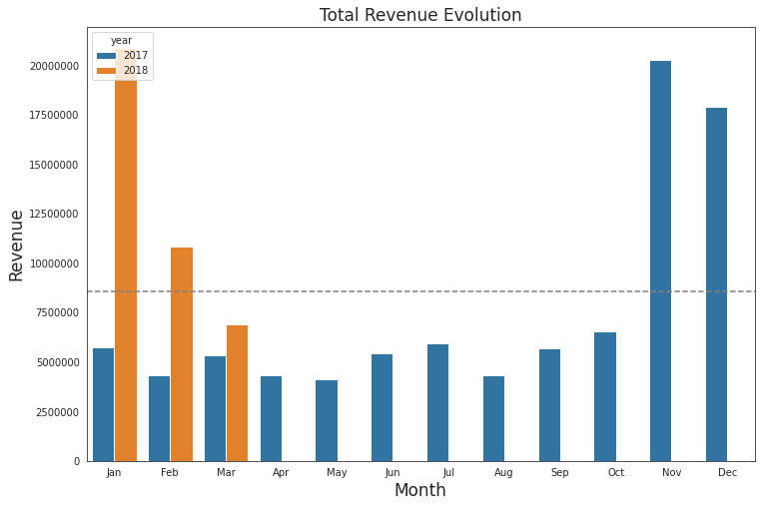
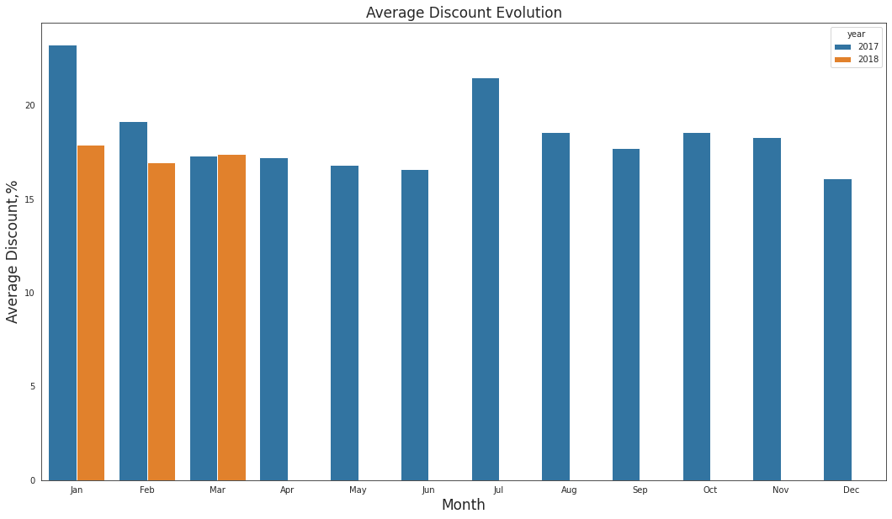
Q1 2018 Revenue is Twice as much as Q1 2017 Revenue
Q1 2018 Average Discount ≊ Q1 2017 Average Discount
Comparison Q1 2018 with Q4 2017 is not applicable: Christmas Sales Season

Slide 4
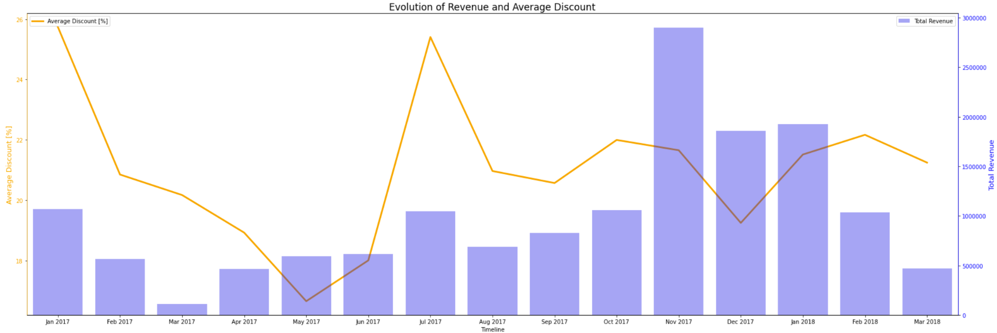
Total Revenue and Discount: No Association
without orders that showed negative discount!

Slide 5
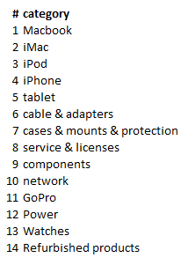
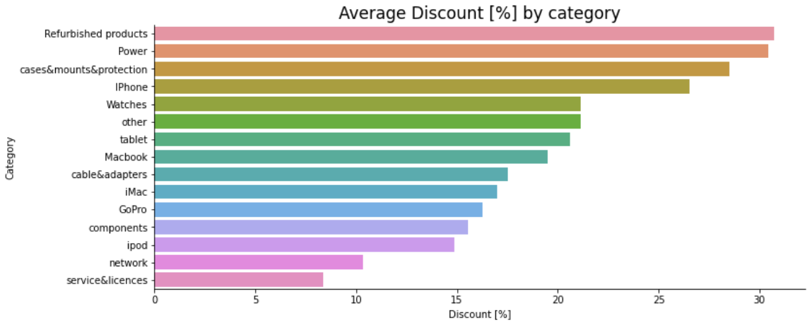
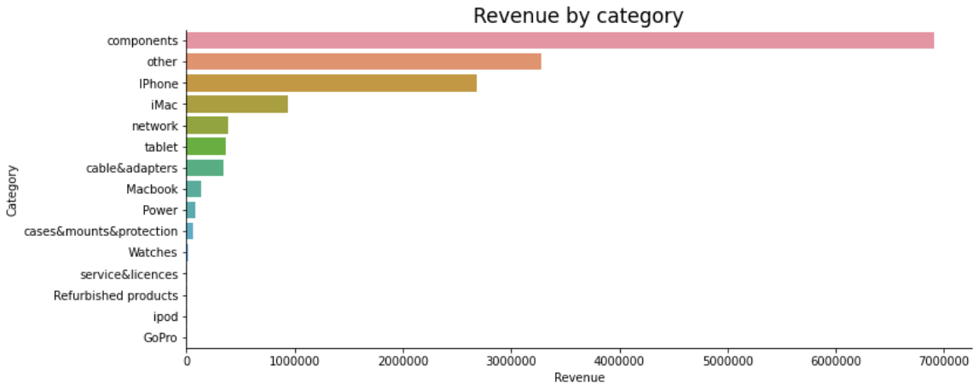
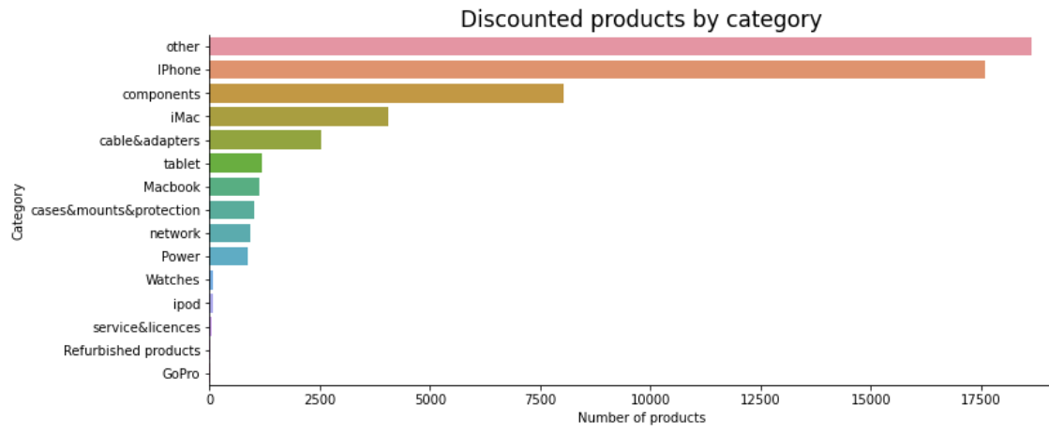
Categories
20% of categories make up 80% of revenue

Slide 6
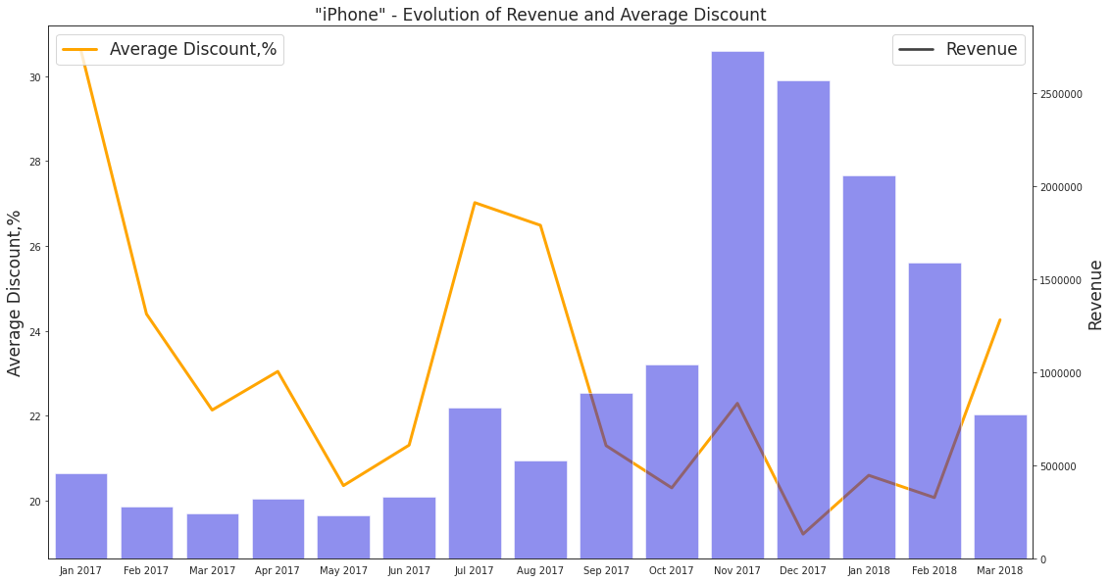
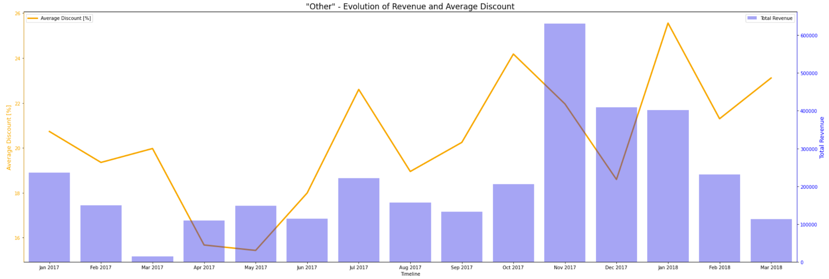
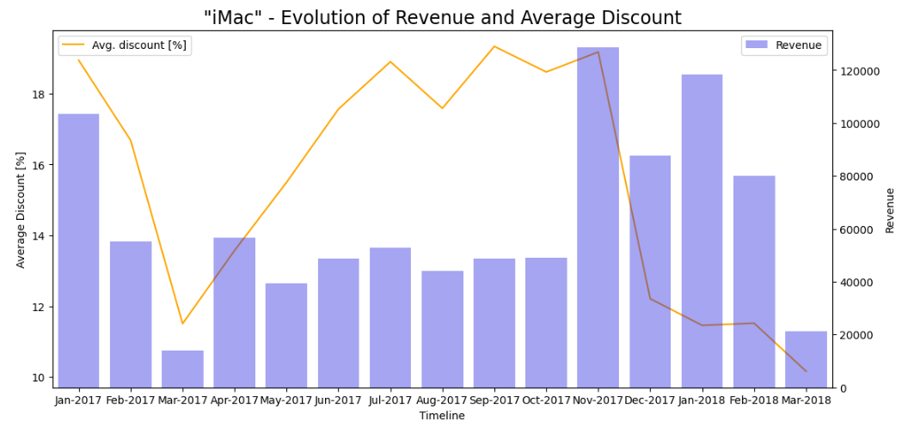
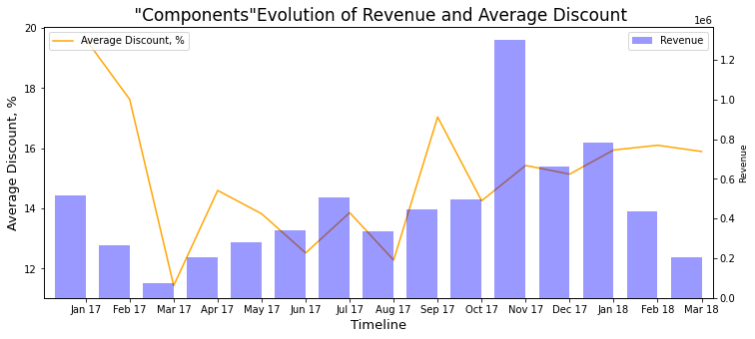

Slide 7
Conclusion
There’s no correlation between discount and revenue
ENIAC’s business is a seasonal business focused heavily on November/December

Slide 8
Recommendations
Keep applying discounts
For January - October:
Keep average discount for loyal big companies
Decrease discounts for new, individual customers, but keep discount close to average of competitors
Better data collection:
Implement customer id
Implement categories and subcategories
Repetition of order_id and id_order should be avoided
One decimal point on RBL-values should be implemented

